Slide 1

What’s New in v17.5
Notes:
Welcome to this session on what’s coming in XG Firewall v17.5. The team is hard at work putting the finishing touches on this release which should be available in Beta form during the first week of October.

Slide 2
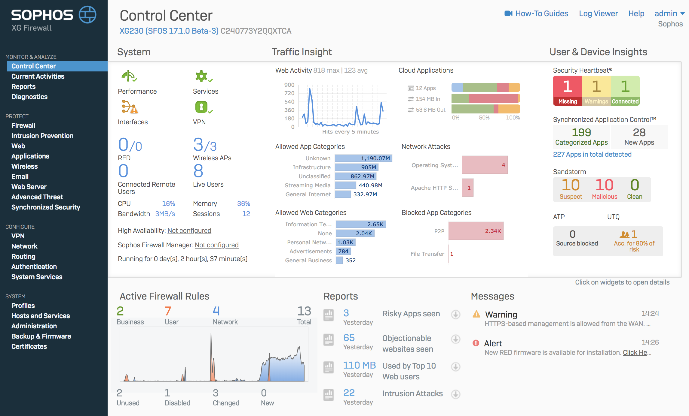



Key New Features in v17.5
Central Management
Synchronized Security
Sophos Central Management
XG Firewall joins Sophos Central:
Manage all your IT security from a
single pane of glass
Wireless
Lateral Movement Protection
Automatic isolation at every point in your network
APX Wireless Access Points
WAVE 2 Performance:
Faster connectivity, higher capacity and
optimal performance
Synchronized User ID
User authentication through Security Heartbeat
Top Requested Features
Education – Protection - Networking
Chromebook Authentication
Web Policy-based SafeSearch
Classroom web policy overrides
Email anti-spam enhancements
Sophos Connect IPSec Client
Firewall rule auto grouping
Log viewer enhancements
Client Authentication App Enhancements
TALOS IPS Enhancements
Airgap deployment support (MR1)
Notes:
The features in v17.5 fall into four categories… and I will go through all of these in more detail, but in summary, XG Firewall is joining Sophos Central, adding new Synchronized Security features, adding support for the new APX wireless access points, and delivering a number of top requested features from customers and partners.

Slide 3
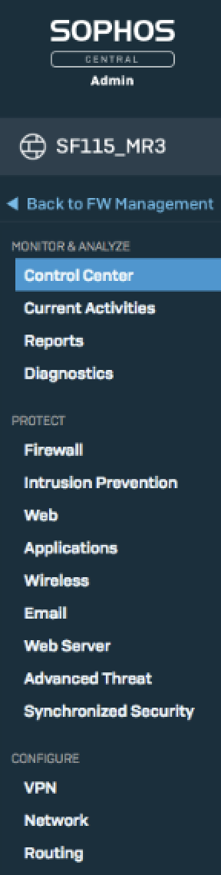
Sophos Central Management – EAP Starting Soon
Your Complete IT Security Management Platform
One Console
View status and manage XG alongside all other Sophos Central products
Full device management via SSO
Secure remote access to all your XG devices via Sophos Central
Alerting and status for availability, license, performance, and security
Manage firmware updates
Option to store/maintain backups in Central
Zero-touch setup of new appliances
Free for partners and customers!
No Additional License Required
Notes:
The addition of XG Firewall management to Sophos Central is a significant milestone as customers now have the option to manage the entire portfolio of Sophos Synchronized Security products in Sophos Central. This includes: Endpoint, Server, Mobile, Device Encryption, Wireless, Email and now XG Firewall.
Firewalls can be joined to Sophos Central quickly and easily and managed from within Sophos Central securely from anywhere without having to enable HTTPS login access from the WAN interface on the firewall. All customer XG Firewall devices will appear in Sophos Central and they can be managed individually as if you were logged onto the actual device. Sophos Central displays the actual user interface from the XG device in Sophos Central so there is no synchronization of settings or configuration between Central and the device required.
There are a few very compelling value added features that come with Central Management of XG… Including…
Backup Management: Additional features that Sophos Central management provides include the option to store regularly scheduled backup files in Central automatically for safe keeping along with easy and convenient access to your historic backup files should they be required.
Alerting: XG Firewall alerts will appear on the main Sophos Central dashboard including connectivity alerts for interfaces and VPN, resource utilization , licensing notifications, and security events.
Firmware Updates: You can manage firmware updates for XG Firewall from within Sophos Central – enabling an easy one-click update to the latest firmware.

Slide 4
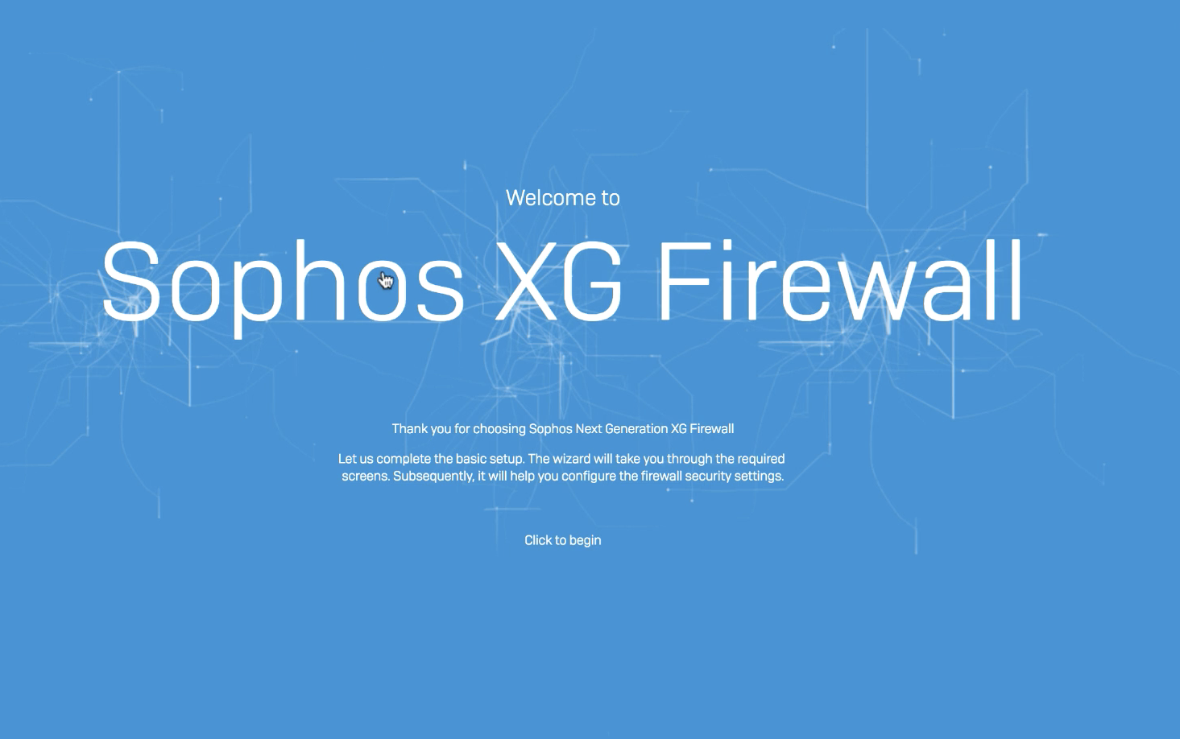
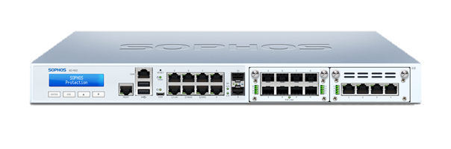
Zero-Touch Deployment
Remote device deployment without an on-site engineer
1. Use the Setup Wizard in Sophos Central
2. (Optional) Email the Config File to the remote site
3. Transfer the Config File to a USB Stick
4. Start the device with the USB stick connected
Notes:
This feature enables even a non-technical person to connect and configure a remote XG Firewall and get it connected into Sophos Central. An administrator can add the new firewall in central and step through the initial setup wizard before the XG device is installed. They can then download the configuration or email it to another location, so it can be copied to a USB stick.
The stick is then plugged into the XG Firewall device when it is first fired up, setting its initial configuration, after which it can be fully managed from Sophos Central. For power users, the config file can be edited and customized further.

Slide 5





Lateral Movement Protection
Automatic system isolation – even on the same broadcast domain
Lateral Movement Protection
XG instantly informs all healthy endpoints to ignore any traffic from a compromised device.
XG Firewall
Security Heartbeat™
Sophos
Endpoints
Security Heartbeat™
Internet
Servers
RED Heartbeat Status
triggers isolation whether the result of endpoint, firewall or IPS signature detection
Notes:
When Synchronized Security was first introduced with XG Firewall, Security Heartbeat™ settings in firewall rules allowed unhealthy endpoints with RED or YELLOW heartbeat status to be isolated by these firewall rules from accessing other parts of the network or the internet.
In this way, Security Heartbeat™ helps isolate infected endpoints to prevent a threat moving or spreading to other parts of the network or communicating out to the internet.
In v17.5, this feature is enhanced further with the ability to isolate unhealthy endpoints even from other endpoints on the same broadcast domain or network segment. In many networks, several endpoints will often be connected through a switch to the firewall, and have unrestricted access to each other on this network segment without any firewall control. This made it impossible for the firewall to intervene and block threats from moving laterally through the switch.
With v17.5, lateral movement protection solves this challenge by automatically informing all healthy endpoints to ignore any traffic coming from any unhealthy endpoints, effectively isolating them completely until they can be cleaned up. Once cleaned up, its Security Heartbeat status will return to GREEN and connectivity with other systems on the network will be automatically restored.
In addition, previously a RED heartbeat was triggered by malicious traffic detection, attempts to call home, or the ATP engine, or the endpoint identifying a threat. Now in v17.5 IPS detections from compromised endpoints trying to exploit a vulnerability can also trigger a RED heartbeat condition and lateral movement protection as well, further enhancing protection from threats on the network.

Slide 6
Synchronized User ID
User identity synchronized between EP and Firewall automatically
Synchronized User ID
XG gets user ID from endpoints automatically that are on an Active Directory domain.
XG Firewall
Security Heartbeat™
Sophos
Endpoints
Internet
Servers
Notes:
User authentication is critically important for all next-gen firewalls to provide user-based reporting and policy enforcement. In a typical Active Directory environment, transparent user identity at the firewall is achieved either by installing an agent on the Directory Server to relay user identity information to the Firewall or on the endpoint to share user identification. These agent solutions can be problematic to deploy in some situations and environments.
With v17.5, Endpoints on an Active Directory Domain, can now share user identity with the Firewall through the Security Heartbeat™ connection. This makes user identification seamless and easy without having to deploy agents on the domain controllers. This feature can be very helpful in many situations, but particularly where inline deployment of XG with other firewalls is desired.
Note this solution is not a replacement for SATC which provides a user identification agent for multi-user systems like terminal services hosts. SATC is still the best solution in these situations. This solution also doesn’t support non-managed devices such as Linux hosts.

Slide 7
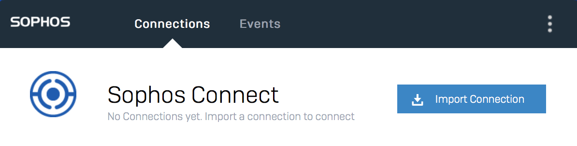
Top Requested Features in XG v17.5
EDUCATION
Chromebook Authentication
Classroom web policy overrides
Web Policy-based SafeSearch
PROTECTION
Email anti-spam enhancements
TALOS IPS Enhancements
FIREWALL AND NETWORKING
Sophos Connect IPSec Client
Firewall rule auto grouping
Log viewer enhancements
Client Authentication App Enhancements
Airgap deployment support
Notes:
There are also a ton of top requested features coming in v17.5 and they will appeal to a broad number of partners and customers, particularly education, but many of these features will be welcomed by everyone.

Slide 8

Chromebook User ID
Enables user-based policy and reporting with Chromebooks
Chromebook Support
XG Firewall gets user ID from Chromebook extension agent to provide full user-based policy and reporting
XG Firewall
1. Google G Suite
Chrome Extension pushed to client devices
2. On-Premise AD Server
XG Firewall configured to use AD Server Synchronized with G Suite
3. Chromebook Devices
Chromebook extension shares User ID with XG Firewall
Notes:
Chromebooks are increasingly popular in education and some corporate environments, but they create a unique set of challenges for user identification with network firewalls. XG Firewall v17.5 provides a Chromebook extension that shares Chromebook user IDs with the Firewall to enable full user-based policy enforcement and reporting. Pre-requisites include an on-premise Active Directory Server synced to Google Gsuite. The Chrome extension is pushed from the Gsuite admin console providing easy and seamless deployment that is transparent to users. This is a feature that a lot of education customers are going to love.

Slide 9
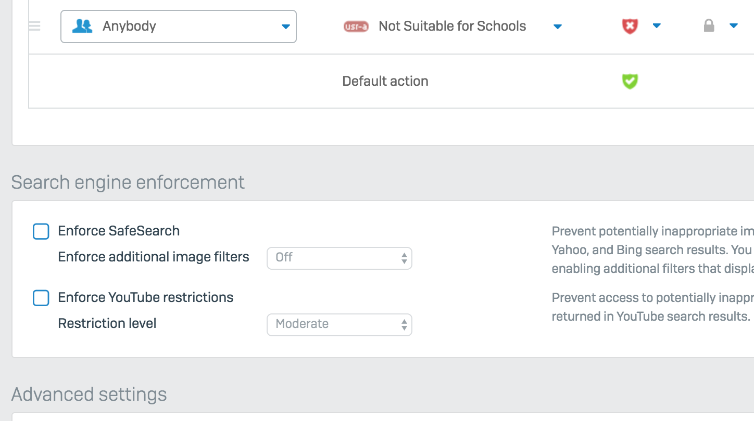
New Web Policy Options
Greater flexibility for SafeSearch, YouTube and unblocking sites for education
What’s New
SafeSearch and YouTube restrictions are now part of web filtering policy settings – enabling user/group based control of these features
Notes:
A few enhancements to web policy enforcement are included in v17.5 that have been highly requested by many customers, particularly those in the education sector. Web policies have been expanded to include many settings that were previously global configuration options. Search engine enforcement, including SafeSearch and YouTube restrictions, along with download file size limits, and Google App domain restrictions are all set on a per-policy basis now providing much greater flexibility in how these controls are applied.

Slide 10
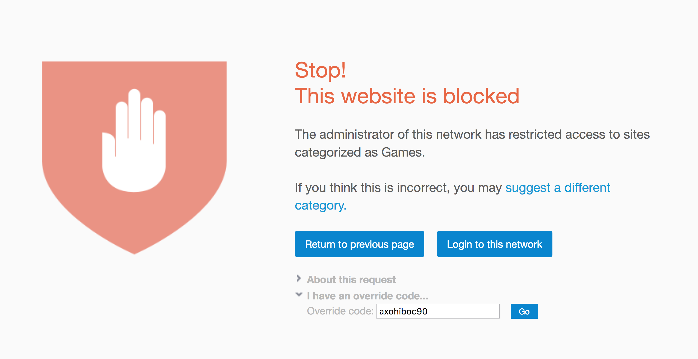
New Web Policy Options
Greater flexibility for SafeSearch, YouTube and unblocking sites for education
What’s New
SafeSearch and YouTube restrictions are now part of web filtering policy settings – enabling user/group based control of these features
Override codes for blocked websites which can be configured/managed by teachers through the user portal
Notes:
Web policy overrides is another top requested feature, again – very much in demand by education institutions.
It allows authorized users, such as teachers, to override blocked sites on user devices – temporarily allowing access. Administrators define which users (or teachers) have the option to authorize policy overrides. Those users can then create their own override codes, like simple passwords, in the XG Firewall User Portal and define rules about which sites they can be used for.
Codes can then be shared with End-users in the class room, who enter them directly into the block page to allow access to a blocked site. Override code rules can be broad – allowing any traffic or whole categories – or more narrow – allowing only individual sites or domains – and can also be limited by time and day. And to avoid abuse, codes can easily be changed or cancelled.
Administrators can see a full list of all override codes created and disable or delete them, as well as defining sites or categories that can never be overridden. There is also a new report providing full historical insight into web override use.

Slide 11
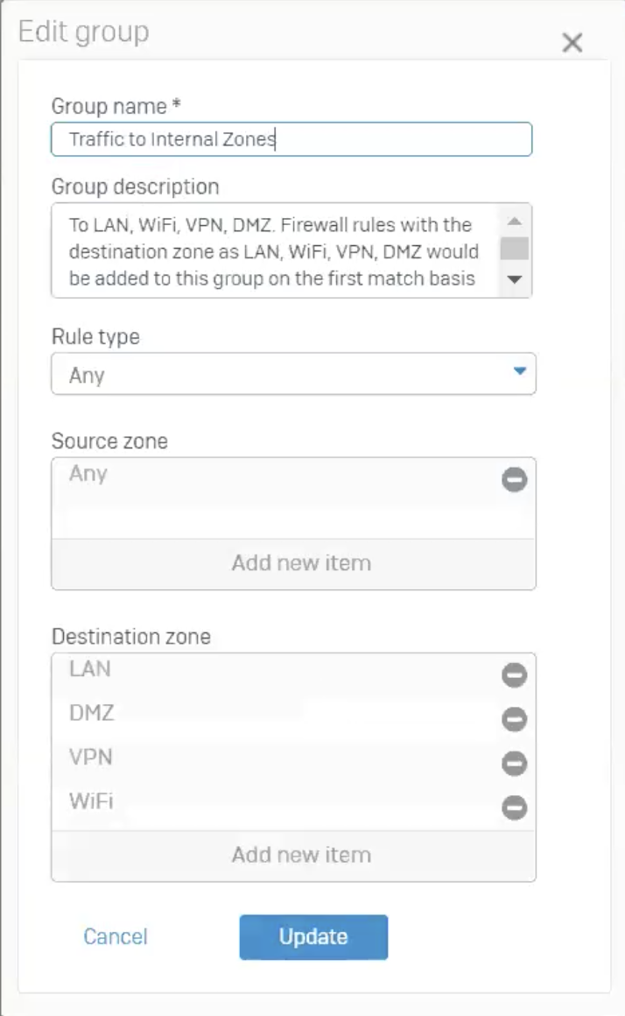
Firewall Rule Grouping
Ideal for larger firewall rule sets
What’s New
Setup matching criteria as part of the group definition for auto group assignment
Notes:
Firewall rule group enhancements include an option to create matching criteria that will be used to automatically assign new rules to that group. You can see an example here where the matching criteria is set to any internal destination zone, so any rule created that matches this critiera like a LAN to DMZ type rule will automatically be assigned to this group.

Slide 12
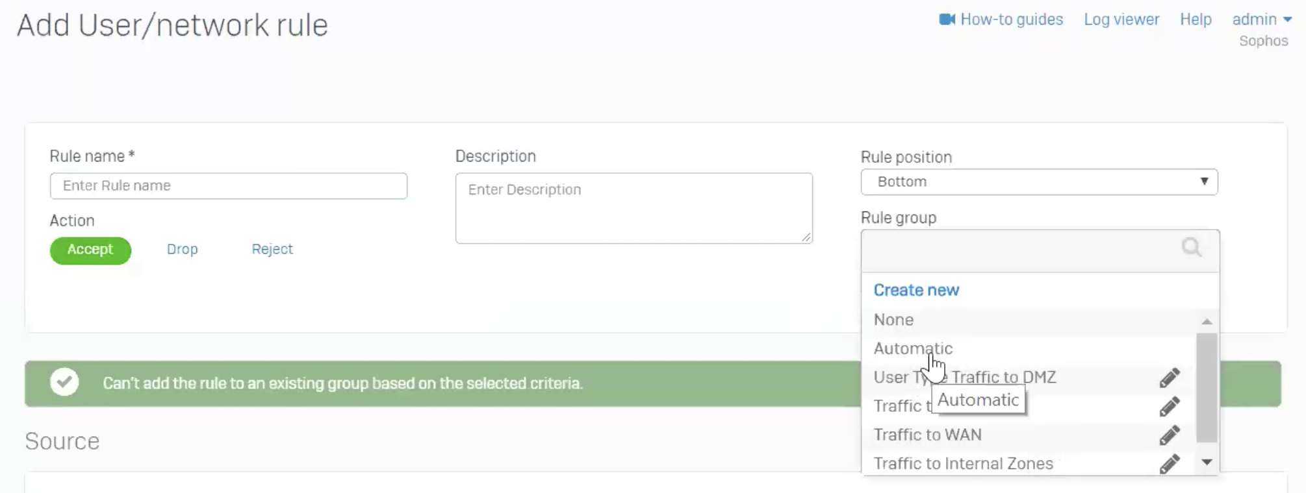
Firewall Rule Grouping
Ideal for larger firewall rule sets
What’s New
Setup matching criteria as part of the group definition for auto group assignment
Select a group when creating a rule or set to automatically be assigned a group
Notes:
After you setup your groups and the matching critiera, you can then select a group when creating a rule from this new drop-down list, and one of the options is “automatic” which will assign the rule to a group automatically based on the matching criteria.
These features will be most welcomed by organizations managing large rule sets.

Slide 13
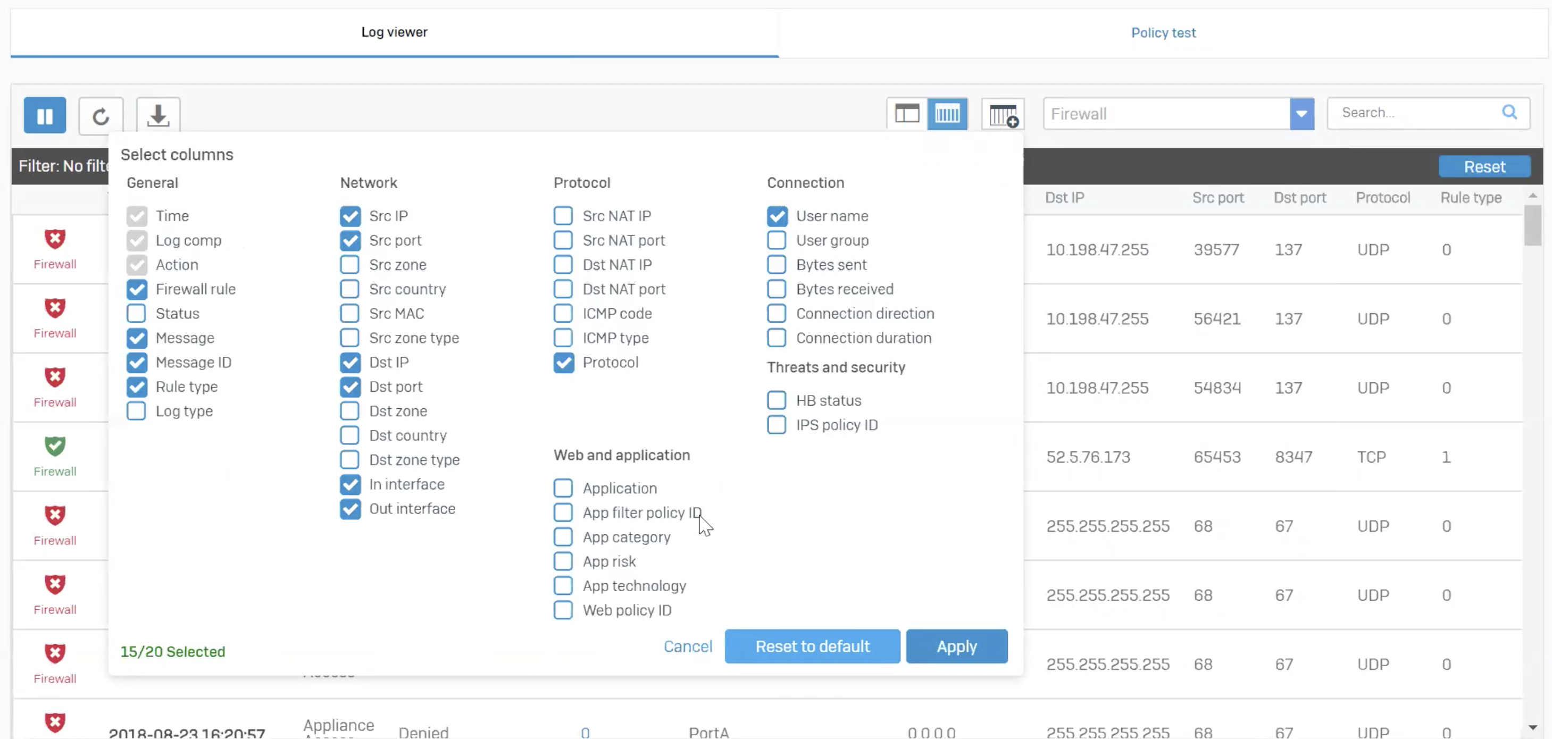
Log Viewer Enhancements
More powerful and streamlined trouble-shooting
What’s New
Column selector - select any 17 columns from a list of 44 possible fields
Rule IDs referenced in logs are hyperlinked to open the related rule in the main console window
Filters sorted alphabetically
Notes:
An all-new XG Firewall Log Viewer was launched with v17 and in this release it gets further enhancements.
In the standard column view, there is a new option as you can see here, to customize the columns displayed in the log viewer. Up to 17 different columns can be selected from the full set of fields that are available based on the selected module being monitored.
Other improvements include an update to the filter list which is now sorted in alphabetical order and now all rule ID’s in log entries are hyperlinked that will open the related firewall rule in the main window when clicked… Making it easy to see what firewall rule is associated with a particular log entry.

Slide 14
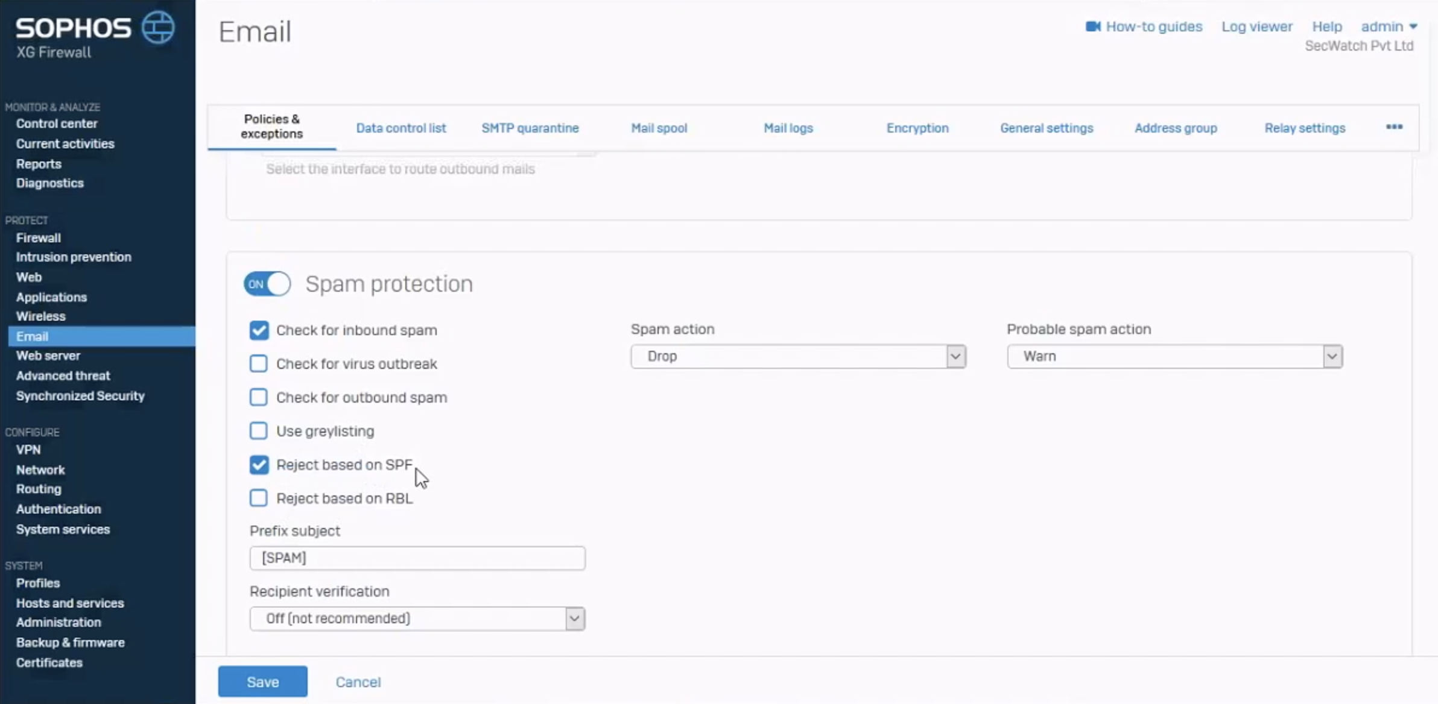
Email Enhancements
Closing top requested feature gaps with SG UTM
What’s New
Recipient verification using Sender Policy Framework (SPF) for spoofing protection
MTA update to Exim
Notes:
XG Firewall email enhancements include verification of the recipient using Active Directory and Sender Policy Framework (SPF) spoofing protection. The Mail Transfer Agent (MTA) is also being updated to Exim which is the same as the MTA used in SG UTM. Together these enhancements address our top requested email features from our SG UTM customers and partners.

Slide 15
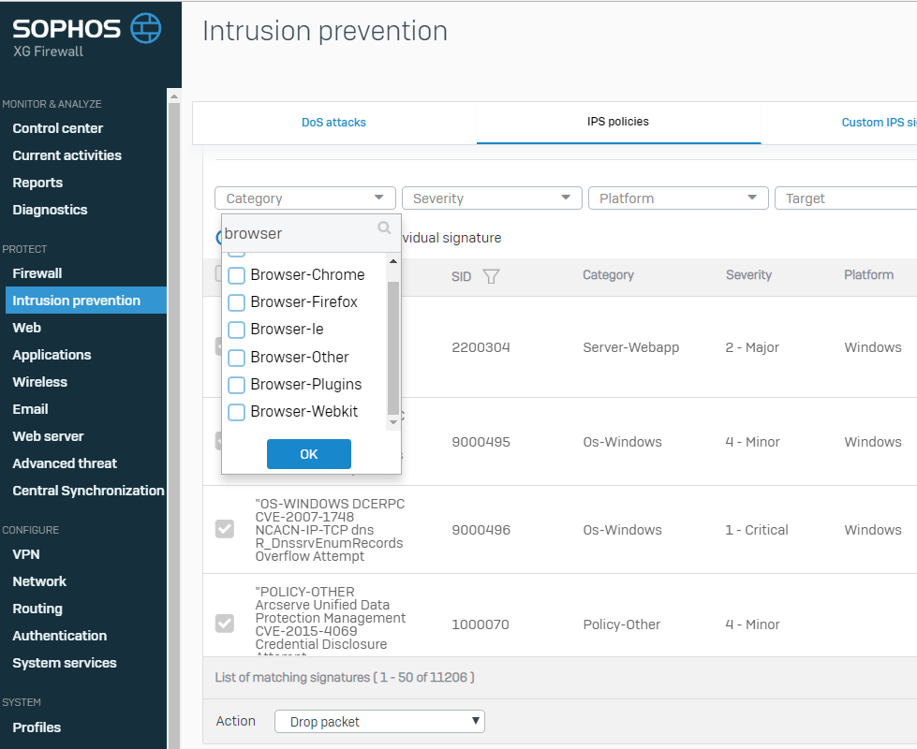
IPS Enhancements
Added IPS policy granularity
What’s New
Added protection with TALOS (Cisco Sourcefire) pattern library augmented with additional patterns from SophosLabs
Increased granularity in policies with 60 categories (up from 21) with an easy inline search option
Notes:
Over time we have been enhancing protection and performance of the IPS engine by adding the Talos commercial IPS signature library from Cisco. We augment the Talos library with additional signatures as required to ensure optimal intrusion protection. The Talos library includes more granular categories, and in v17.5 we are making those available in the IPS policy tool, making it easier to build more granular IPS policies. As you can see here, you can get very specific with category selection such as which particular browser you want to select IPS patterns for.
For those wondering, Talos is a highly respected network security analysis group working around the clock to respond to the latest trends in hacking, intrusions, and malware… just like our own SophosLabs. So this is a great partnership that bolsters our IPS protection and also provides more granular IPS policy controls.

Slide 16
Sophos Connect IPSec Client
Free client for easy, reliable VPN connections
What’s New
Easy deployment and maintenance
Client MSI can be pushed per machine via active directory or other install tools
Client config install can be automated via script
Simple operation requires no user education
Free for partners and customers!
Notes:
With v17.5 we are launching Sophos Connect, a new IPSec VPN Client that makes VPN connections easy to deploy and seamless for end-users to utilize. Connection profiles can be easily deployed or added at any time. The application runs as a system try or menu bar item on Windows and Macs respectively. It is freely available for all XG Firewall customers and partners.

Slide 17
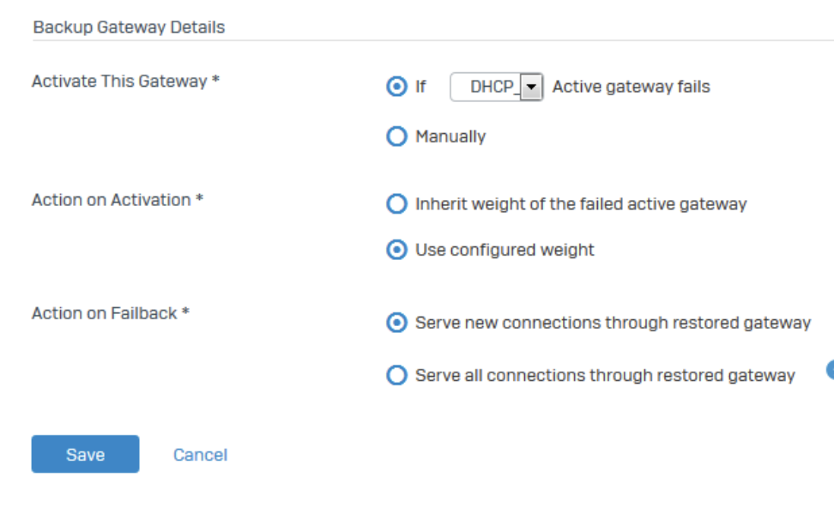
IPSec and SD-WAN Failover and Restore
Providing more flexibility on connection failover and recovery
What’s New
Redundancy options for IPSec tunnels for auto failover and restore
WAN Link restore options for serving all connections through the restored link or just new connections
Notes:
You can now set redundancy groups for IPSec tunnels that will handle fail-over automatically in the event of a disruption and restore once the primary link is available. There is also now a similar option for WAN link restoration following a fail-over as well that will either assign only new connections to the restored link or all connections.

Slide 18
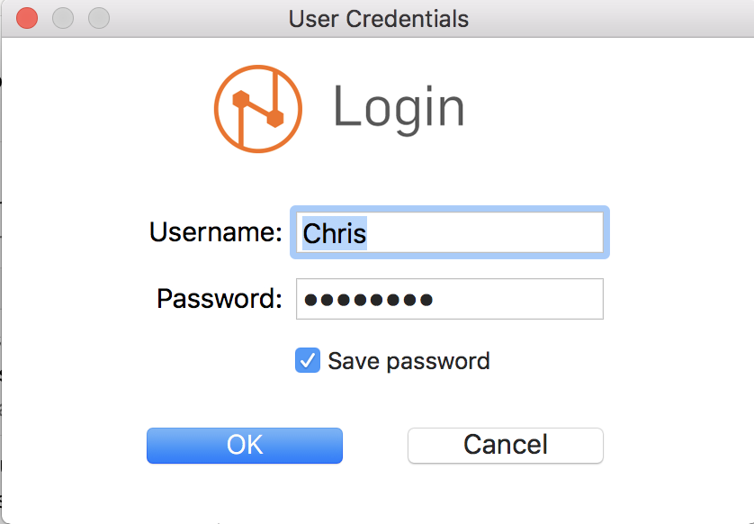
Sophos Client Authentication
Providing a number of deployment and usability enhancements
What’s New
Per-machine deployment (not just per-user as before)
Option to hide on startup
User can logout
Reconnect after sleep
MAC Address telemetry sharing
Windows XP support
Notes:
The XG Firewall Client Authentication Agent is a very popular authentication method, especially with our Cyberoam customers, and in v17.5 it gets a number of important enhancements including per-machine (rather than per-user) installation support, an option to hide on startup, an option for the user to explicitly logout, automatic reconnection on wake from sleep, MAC address telemetry sharing to support MAC address filtering as well as support for Windows XP.

Slide 19
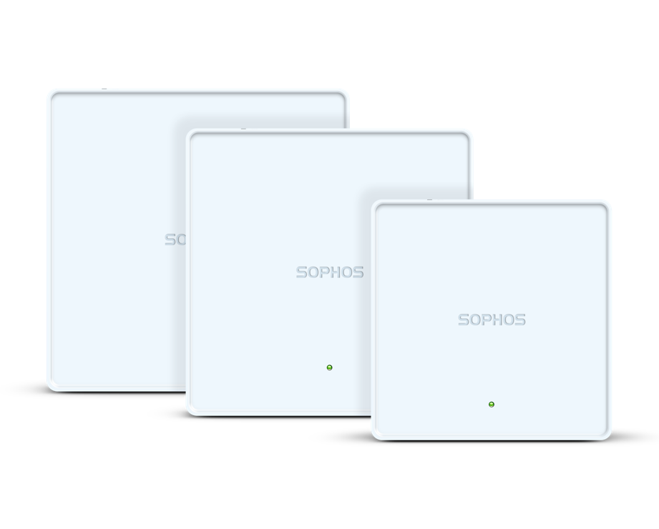
APX – Wave 2 Access Points – Coming in v17.5 MR1
Faster, Better WiFi
Faster Connectivity – up to 2.3Gbps
High density – high capacity
Optimized performance – per device
APX 740: Flagship high-density, high-capacity for the mid-market enterprise
APX 530: High performance for typical office environments
APX 320: Dual 5 GHz based access point, perfect for tablets/phones, high-density environment in education, small retail scenarios
APX will not be certified in all regions initially.
No launch planned in China, Taiwan, Malaysia. Japan will be late 2018, as will Brazil.
Notes:
Support for the latest Wave 2 APX Series wireless access points will be provided in a follow-on maintenance release shortly after the release of v17.5. This is a great opportunity for XG firewall customers to refresh their wirless access points to the latest technology that delivers up to twice the connectivity speed, greater capacity in high density environments and optimized performance… There’s three compelling new models to choose from, the APX 740, 530, and 320 which all over state of the art 802.11AC wave 2 wireless performance. Everyone loves new hardware, so this promises to be a hot update for everyone.

Slide 20
Notes:
That concludes our sneak peak at v17.5 which as I mentioned should be available in early October for beta and preview, with GA to follow in November. I’ll now turn it over to Alan who will address your questions.

